Slide 1
Image based breed recognition for cattle and buffaloes of India
CSE7302 – University Project
Batch Number: COM_10
Under the Supervision of,
Dr./Mr./Ms./Prof. Murali Parameswaran
Professor / Associate Professor / Assistant Professor
School of Computer Science and Engineering
Presidency University
Student Name | Roll Number
AMISHA | 20221COM0170
KAVYA D K | 20221COM0179
Name of the Program: Computer Engineering
Name of the HoD: Dr.Gopal krishna shyam
Name of the Program Project Coordinator: Ms. Sumitha Guddin
Name of the School Project Coordinators: Dr. Sampath A K , Dr. Geetha A

Slide 2
Problem Statement Number: SIH25004
Organization: Presidency University
Category : Software
Problem Description: - The manual identification of cattle and buffalo breeds in India is time-consuming, error-prone, and highly dependent on expert knowledge. Due to variations in appearance, lighting, and image quality, traditional methods are inefficient and inconsistent. Hence, there is a need for an automated image-based breed recognition system using deep learning techniques to accurately identify Indian cattle and buffalo breeds from images.

Slide 3
Content
Problem Statement
Objectives
Algorithms used
System Architecture
Models used
Accuracy results
Project Implementation
Timeline of the project
Conclusion
References

Slide 4
Problem Statement:
Manual identification of Indian cattle and buffalo breeds is a time-consuming and expertise-dependent process, often leading to errors that hinder effective livestock management, breed conservation efforts, and optimal breeding programs. With over 70 distinct indigenous breeds at risk of decline, there is an urgent need for an automated, accessible system that can accurately recognize breeds from images. This project addresses this gap by developing a deep learning‑based recognition system that leverages multiple convolutional neural network architectures to classify breeds from photographs, enabling farmers, researchers, and conservationists to identify animals quickly and reliably.

Slide 5
Objectives
Develop a deep learning system using transfer learning to automatically identify Indian cattle and buffalo breeds from images.
Implement and compare Six pre‑trained CNN architectures—MobileNetV2, MobileNetV3, DenseNet121, EfficientNetV2S, and EfficientNetB3, ConvNext —to determine the most effective model for breed classification.
Preprocess and augment a dataset of images across breeds to enhance model generalization and performance.
Optimize the models using TensorFlow Lite with quantization to enable efficient, real‑time deployment on web and mobile platforms.
Build a user‑friendly web application that allows users to upload an image and receive breed predictions with confidence scores, aiding farmers and conservationists in breed identification.

Slide 6
Algorithms used
We employed five deep learning architectures based on Convolutional Neural Networks (CNNs):
MobileNetV2 – Lightweight model using inverted residuals and linear bottlenecks.
MobileNetV3 Large – Optimized version with H-Swish activation and squeeze‑and‑excitation blocks.
DenseNet121 – Densely connected convolutional network for feature reuse.
EfficientNetV2S – Efficient scaling model with improved training efficiency.
EfficientNetB3 - Balanced version of EfficientNet with compound scaling.
ConvNext – Modernized CNN with inverted , improve accuracy.

Slide 7
The project is based on Convolutional Neural Networks (CNNs) with transfer learning. Five pre‑trained CNN architectures—MobileNetV2, MobileNetV3 Large, DenseNet121, EfficientNetV2S, and EfficientNetB3, ConvNext —were used as feature extractors, fine‑tuned on the cattle breed dataset. The core algorithm is deep learning using CNNs for image classification.

Slide 8
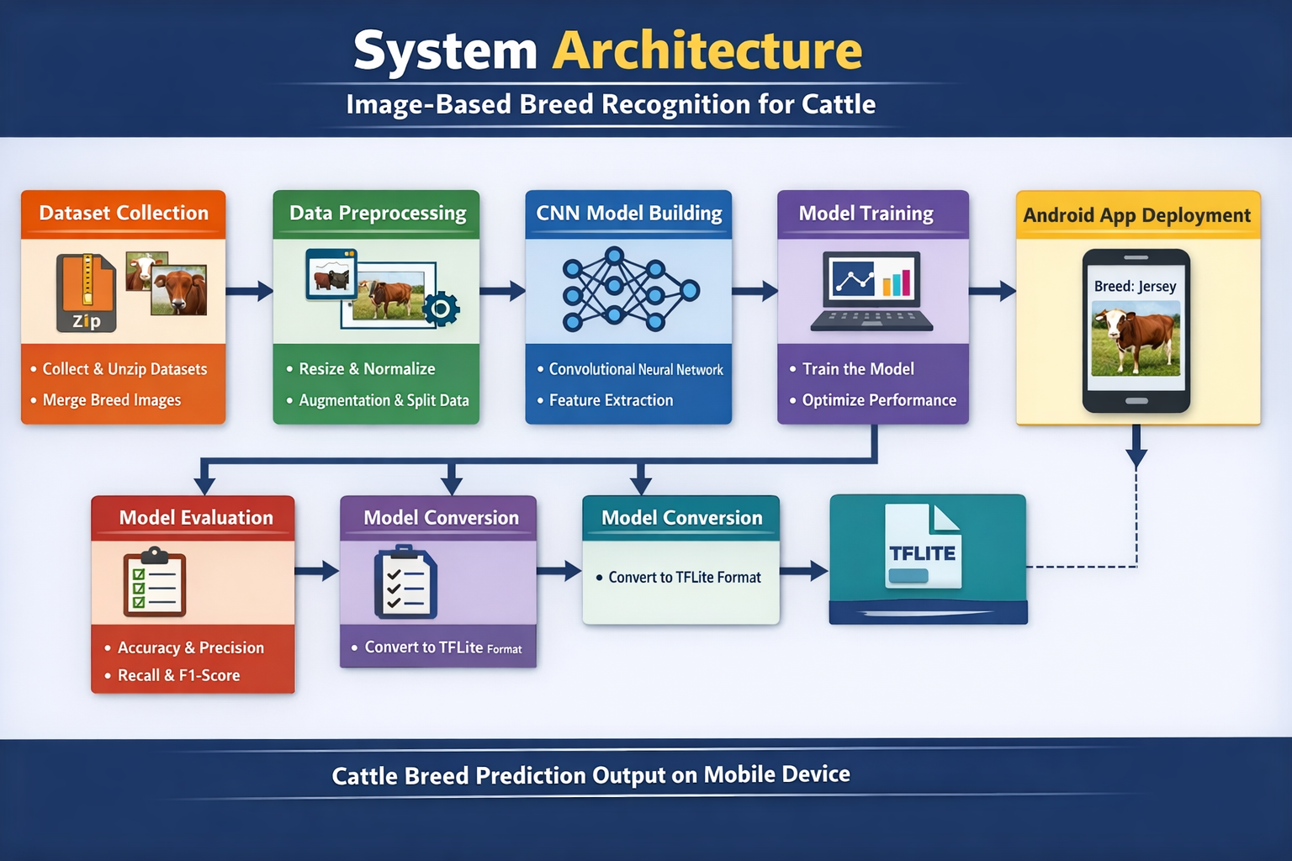
Architecture

Slide 9
6 Models used
MobileNetV2 – Lightweight model using inverted residuals and linear bottlenecks.
MobileNetV3 Large – Optimized version with H-Swish activation and squeeze‑and‑excitation blocks.
DenseNet121 – Densely connected network for strong feature reuse and gradient flow.
EfficientNetV2S – Efficient scaling with improved training efficiency and architecture.
EfficientNetB3 – Balanced EfficientNet variant with compound scaling for higher accuracy.
ConvNext : To Built Convnext Model to improve High accuracy.

Slide 10
6 Model Accuracy Results
Model | Accuracy
MobileNetV3 Large | 92.74%
MobileNetV2 | 89.25%
DenseNet121 | 85.22%
ConvNext | 90.35%
EfficientNetV2S | 82.12%
EfficientNetB3 | 87.83%

Slide 11
Project Implementation
Environment Setup – Python 3.12, TensorFlow, Keras, Flask, and required libraries installed.
Data Collection – Two datasets (Indian Bovine Breed + Indian Cattle Breed Image) merged into one folder with images across breeds.
Preprocessing – Images resized to 160×160, normalized to [0,1], and split 80‑20 for training and validation.
Data Augmentation – Rotation, zoom, horizontal flip, and shifts applied to training data.
Model Selection – Six pre‑trained CNNs (MobileNetV2, MobileNetV3, DenseNet121, EfficientNetV2S, EfficientNetB3, Convenext) loaded with ImageNet weights.

Slide 12
Transfer Learning – Base layers frozen; custom classification head added.
Training – Models compiled with Adam optimizer and categorical cross‑entropy, trained for up to 20 epochs with early stopping and learning rate reduction.
Evaluation – Validation accuracy, precision, recall, F1‑score, and confusion matrices computed for each model.
Optimization – Trained models converted to TensorFlow Lite with post‑training quantization for size reduction and faster inference.
Web Application – Flask backend loads all five TFLite models; frontend allows image upload and displays breed predictions with confidence.
Testing – Application tested locally; users upload images and receive predictions from all models in real time.

Slide 13
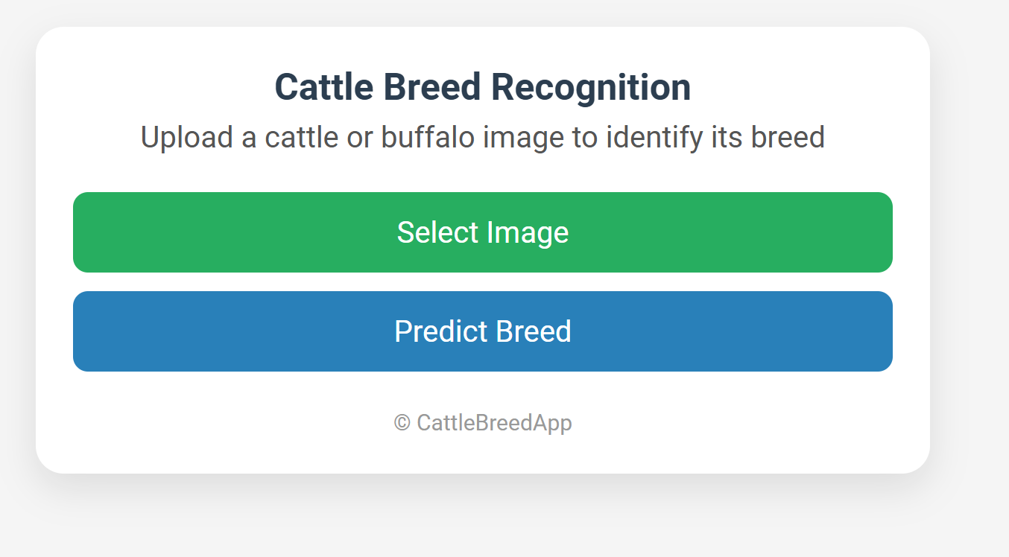
Result :

Slide 14
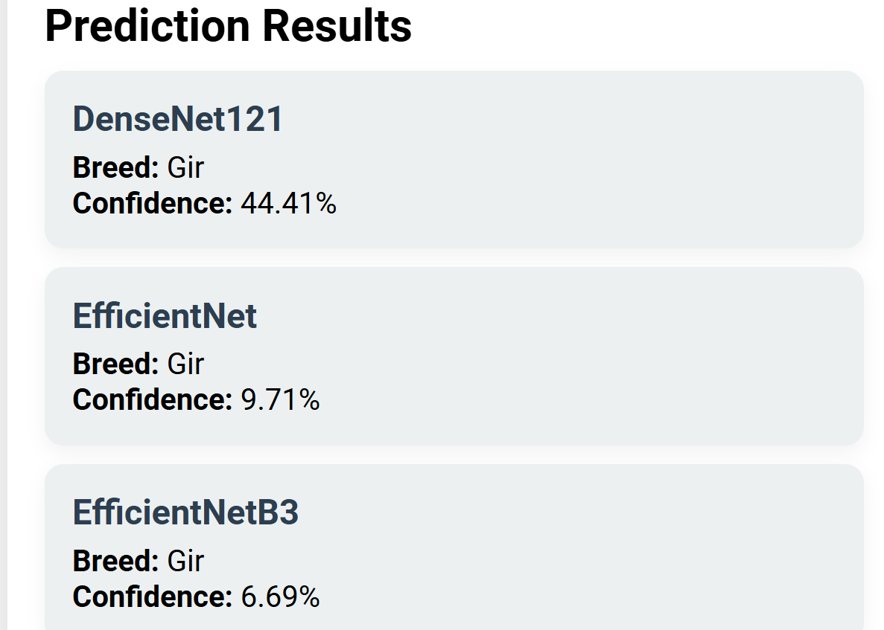

Slide 15
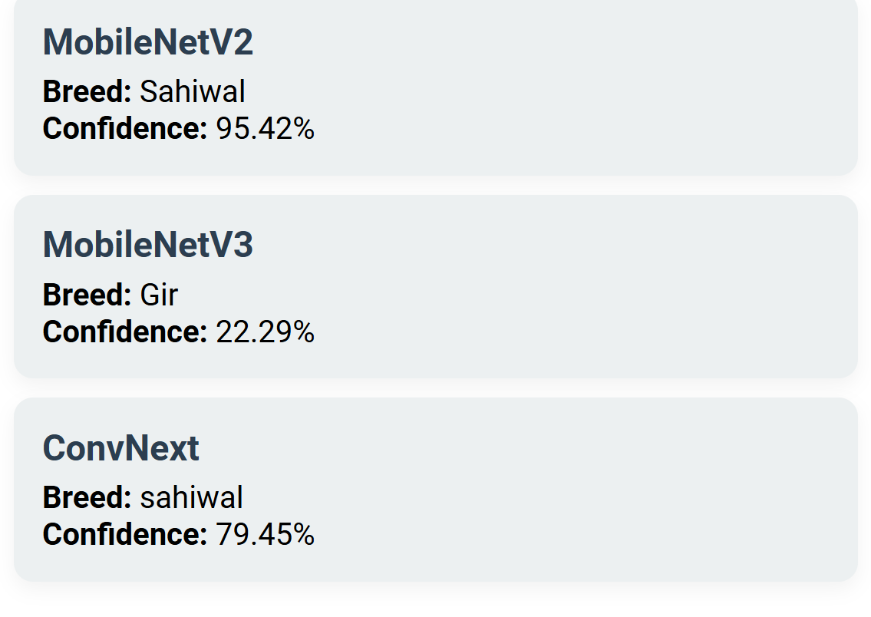

Slide 16
This project is a cattle breed recognition system that uses six TensorFlow Lite (TFLite) deep learning models. An image from the dataset is uploaded, and each model processes the image to predict the cattle breed. The system displays the predicted breed along with confidence scores from each model, allowing easy comparison of results. Using multiple models helps improve accuracy and ensures more reliable predictions when most models agree on the same breed.

Slide 17
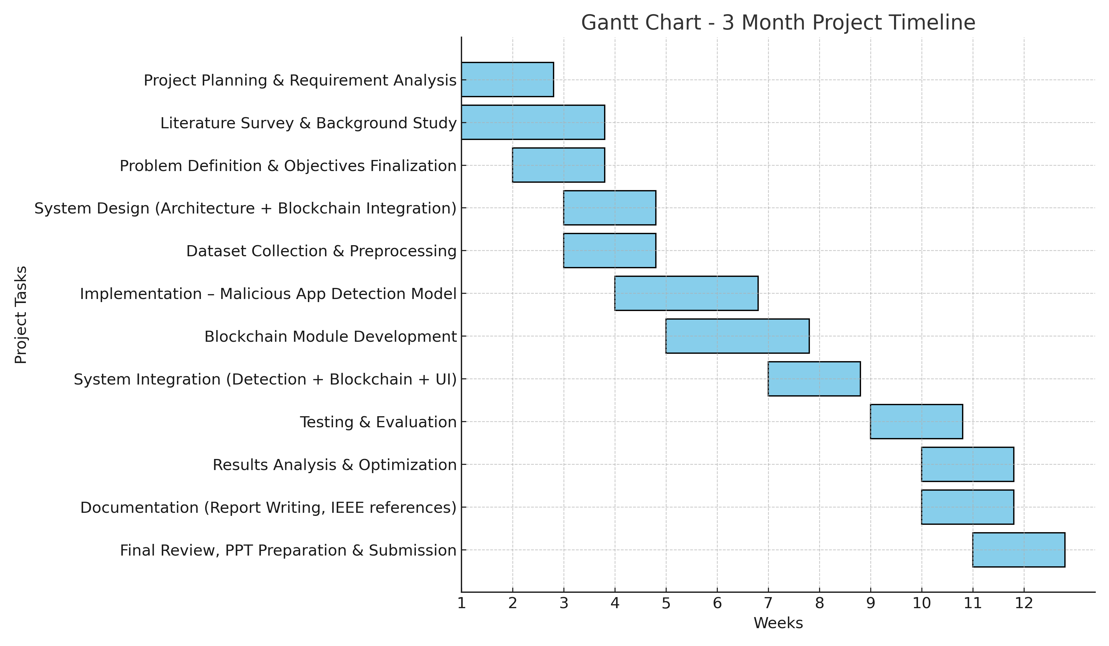
Timeline of the Project (Gantt Chart)

Slide 18
GitHub Link
https://github.com/Amisha170/University-Project-CSE7302-Image-based-breed-recognition-for-cattle-and-buffaloes-of-India-

Slide 19
Conclusion
We developed a deep learning system for Indian cattle and buffalo breed recognition using Six CNN models—MobileNetV2, MobileNetV3, DenseNet121, EfficientNetV2S, ConvNext and EfficientNetB3—trained on images across breeds. MobileNetV3 achieved the highest validation accuracy (55.86%). The models were optimized with TensorFlow Lite and deployed via a Flask web application, allowing users to upload images and receive breed predictions with confidence scores. This tool supports farmers and conservationists in breed identification. Future work includes dataset expansion, ensemble methods, and a mobile app for wider accessibility.

Slide 20
References (IEEE Paper format)
A. B. Valsang and A. Keshi, “Image Based Breed Recognition for Cattle and Buffaloes Using AI,” Int. J. Innov. Res. Technol., vol. 12, no. 8, Jan. 2026.
H. Gupta, P. Jindal, O. P. Verma, and R. K. Arya, “Computer Vision-Based Approach for Automatic Detection of Dairy Cow Breed,” Electronics, vol. 11, no. 22, p. 3791, 2022.
Y. Pan et al., “Identification of Buffalo Breeds Using Self-Activated-Based Improved Convolutional Neural Networks,” Agriculture, MDPI, 2022.
A. Ait Achour and A. Mourhir, “Automated Recognition of Cattle’s Breed Through Computer Vision,” in Proc. 6th Int. Conf. Intelligent Computing in Data Sciences (ICDS), 2024,

Slide 21


